Slide 1

A TRICS SAM Survey
at Wembley Park
Owen Edwards, Project Manager, TRICS Consortium Limited
Notes:
For this presentation, I’ll be looking at the TRICS SAM survey we carried out at the Wembley Park Estate in Spring 2023 and how we went about tackling this monumental challenge.

Slide 2
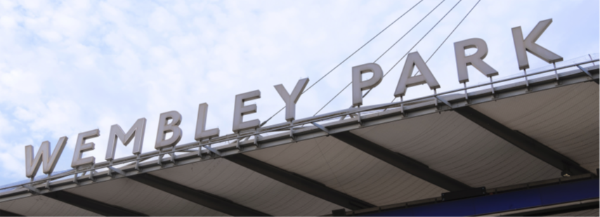
The Beginning
The first contact for this survey was made in March 2022.
Meeting arranged at Wembley Park with Quintain in early May to cover the requirements of the survey.
Notes:
Let’s start at the beginning. All the way back in late March 2022, Ahmed from Quintain, who is here today, emailed Ian about the possibility of carrying out a TRICS SAM Survey at the Wembley Park Estate. A first meeting was arranged via email and Ian went to visit Ahmed at Wembley Park in early May. The meeting went very well, with the two of them agreeing it could be possible for TRICS to carry out a SAM survey at the site. Ian shared the current TRICS Multi-Modal Methodology, a guidance note for site operators and the TRICS data collection form with Ahmed so he and his colleagues at Quintain could have a more complete understanding of the whole SAM survey process and the work involved.

Slide 3
The Next Steps
Following the first meeting in May 2022, there would need to be a site visit arranged and a survey specification written up.
Ian contacted MHTC, one of our TRICS approved data collection contractors, to find out if they were keen on the idea of taking on the challenge.
MHTC were first on the list for this project as they had previous experience of surveys at Wembley Park as well as our busiest ever surveys at Westfield London.
Notes:
The next steps, following that first meeting at Wembley Park in May 2022, were to bring me into the process, as I would be responsible for the site visit and the survey specification, and also to find a TRICS approved data collection contractor mad enough to agree with us a TRICS SAM survey could be feasible. Ian contacted MHTC as they had previously carried out a couple of TRICS surveys at Wembley Park before, but these were at individual elements of the site. MHTC have also helped us deliver several of our busiest ever surveys, at Westfield London in Shepherd’s Bush. Some of you may remember Marie from MHTC, who is also here today, delivered a presentation at one of our previous events about their experience surveying at Wembley Park in 2015, when an unexploded Second World War bomb was discovered nearby during one of the surveys, which of course meant the survey had to be abandoned!

Slide 4
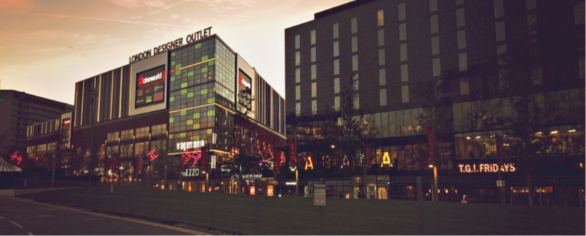
The Survey Scope
Initial thoughts considered surveying just some of the major elements of the site and extrapolating the results.
MHTC have previous experience of large scale TRICS SAM surveys.
Notes:
Now we had a data collection contractor onboard, we had to decide what was to be included in the survey so a specification could be written up for the survey day itself. The first meeting between TRICS and Quintain concluded the whole Wembley Park estate would need to be surveyed. There had been initial thoughts it could be more economical to survey some major elements of the site and then extrapolate those results to apply to the whole development. Wembley Stadium and OVO Arena Wembley were to be excluded from the survey. This meant finding a survey day where there were no events at either venue. MHTC have previously carried out several TRICS SAM surveys at very large-scale developments, including the previously mentioned Westfield London in Shepherd’s Bush. The experience of these surveys would be crucial to delivering the Wembley Park survey.

Slide 5
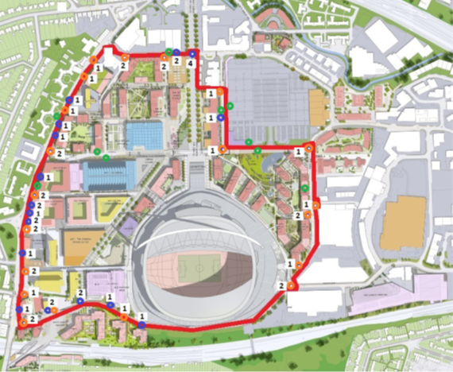
The Wembley Park Estate
Defining the Wembley Park Estate site boundary not as easy as it sounds.
Ian carried out a virtual site visit using Google Maps Street View in June 2022.
Notes:
Once it was confirmed the whole Wembley Park Estate was to be surveyed, it was time to mark the site boundary out to assess how many accesses there might be. This first step of drawing the site boundary was not as easy as it might sound. The image on this slide shows the results of a virtual site visit Ian carried out in June 2022, using Google Maps Street View as a guide. Once a physical site visit took place, the site boundary changed quite dramatically from that shown, especially along the western boundary and in the south-west corner.

Slide 6
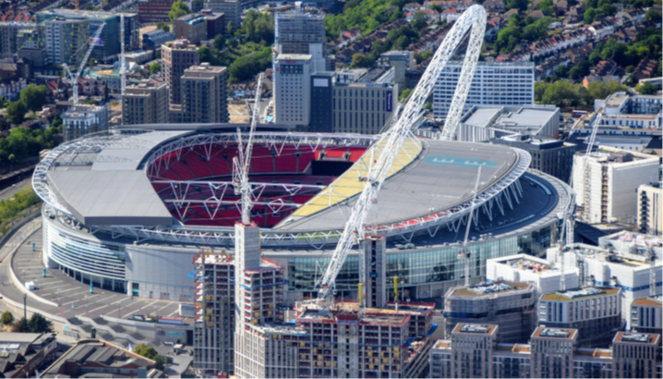
A Brief History
Quintain has invested £2.8bn since 2002 and the site now has outline planning consent for over 950,000m² of mixed-use development, including office space and 5,000 homes.
Notes:
Now is probably a good time to give a brief history of the Wembley Park Estate and Quintain’s involvement with it. Quintain purchased the estate in 2002 and began redevelopment of the site in 2004. In the past 20 years, many changes have occurred on the site, and it now has outline planning consent for over 950,000m² of mixed-use development. This includes over 5,000 homes, with a final target of 6,000 homes, and office space developments, such as the new Brent Civic Centre. The estate is now home to many major developments, including Wembley Stadium, OVO Arena Wembley, London Designer Outlet, Boxpark Wembley and Troubadour Wembley Park Theatre.

Slide 7
Public Transport Connectivity
Many sets of bus stops, internal and external, served by numerous bus routes.
Three bus services run through the site, stopping at several sets of on-site bus stops.
Wembley Park Station on the Jubilee and Metropolitan Lines.
Wembley Stadium Station served by Chiltern Railways.
Wembley Central Station served by Southern, also on the London Overground network and the Bakerloo Line.
Notes:
The site is incredibly well connected with lots of local public transport provision. There are many sets of bus stops, both internal and external, available to users of the Wembley Park Estate, and these are served by numerous bus routes. Three of these bus services run through the site, stopping at several sets of on-site bus stops. For train connectivity, Wembley Park Station, at the north of the site, is on the Jubilee Line, which runs between Stanmore and Stratford, and the Metropolitan Line, which runs between Aldgate and any of Uxbridge, Amersham, Chesham or Watford. Wembley Stadium Station, in the south-west corner of the site, is served by Chiltern Railways, including services from London Marylebone to High Wycombe and Oxford. Finally, Wembley Central Station is just under a 1km walk from the estate and is served by Southern, including services from East Croydon to Watford Junction, the London Overground network, including services from London Euston to Watford Junction, and the Bakerloo line, which runs between Harrow & Wealdstone and Elephant & Castle.

Slide 8
Travel Plan Features
Travel plan implemented in October 2019 with the main objective in line with the Mayor’s Transport Strategy.
Bus routes introduced and extended through the site.
Olympic Way and White Horse Bridge improved.
New pedestrian crossings and traffic calming measures.
Cycle parking meets the London Plan standard and car parking is well below the GLA maximum standard.
Notes:
The Wembley Park Estate travel plan was implemented in October 2019 and the main objective is in line with the Mayor's Transport Strategy. This outlines an aspiration for 80% of journeys to be made by active and public transport modes by 2041. The Wembley Park Estate travel plan also has a mode share target of no more than 20% car driver trips on a weekday over a 24-hour period. Since Quintain purchased the site in 2002, the site has seen the introduction of bus route #206 in 2011 and the extension of bus route #440 in 2019, both of which stop several times in both directions within the site boundary. There have been significant cycle and pedestrian facility improvements, including Olympic Way and White Horse Bridge. Quintain have also implemented three new pedestrian crossings and other traffic calming measures on internal roads. Finally, new buildings within the estate have cycle parking to meet the London Plan standard and car parking well below the GLA maximum standard.

Slide 9
The First Physical Site Visit
The first physical site visit took place on 27th July 2022, ahead of a planned October or November survey.
James from MHTC and I toured the site boundary before meeting Ahmed and the Quintain team.
Meeting with Quintain helped us understand the site further.
Following the physical site visit, I reassessed the number of vehicle, pedestrian and bus stop accesses.
Notes:
Using Ian’s annotated map from the virtual site visit as a guide, I met James from MHTC outside Boxpark Wembley and, from there, we toured the boundary of the site, doing our best to determine where the boundary should be placed, trying to figure out if every building along the site boundary should be included and where it might be possible to fix cameras for monitoring purposes during the survey itself. The site visit took around two hours and, afterwards, James and I met Ahmed at the Quintain offices, where the Quintain team were able to help answer all the questions we’d written down during the site visit. In the following days, I had the unenviable job of attempting to put together a survey specification. It was clear it wouldn’t be possible to do this in the normal way and it would require MHTC’s input to complete this successfully.

Slide 10
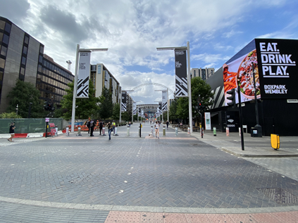
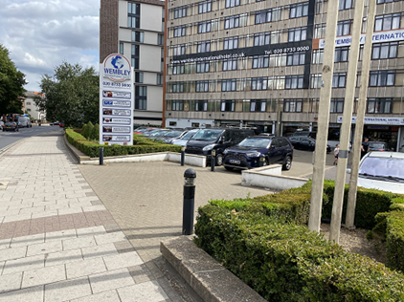
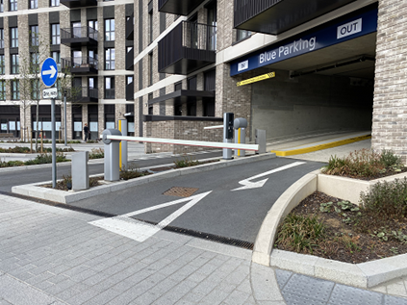
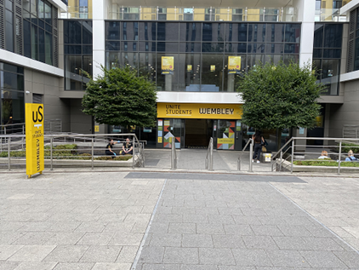
The First Physical Site Visit
Notes:
I took 124 photos during the first site visit, which I believe is a record for a TRICS site visit, and once I returned to the office, I went through my findings with Ian so the survey specification could be attempted. Several Teams meetings took place between TRICS and MHTC to make sure we both had everything recorded and to discuss how we could tackle such an immense site while still delivering a TRICS compliant SAM survey. A slightly altered survey methodology would need to be adopted to capture everything within the resources available.

Slide 11
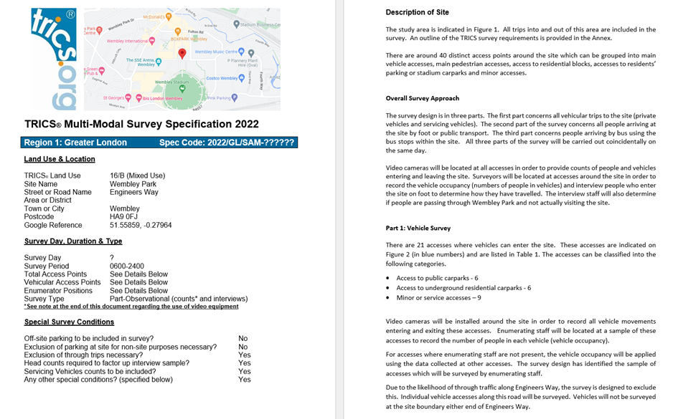
The First Survey Specification
Notes:
The first survey specification included 21 vehicle accesses, 26 pedestrian accesses and 4 internal bus stops. For those of you familiar with TRICS survey specifications, you’ll notice the front page is very similar to normal but, following this, a completely different way of outlining what was required from the survey was needed, with a full explanation of the adapted survey methodology to be used.

Slide 12
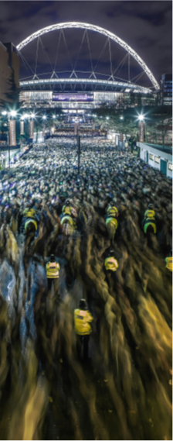
Finding a Survey Date
This is usually the easiest part of the TRICS SAM survey process.
Needed to avoid any event days at either Wembley Stadium or OVO Arena Wembley.
Also needed to avoid any major setting up or setting down days for events at the site.
A date in November was found but this could be booked by either venue at any time.
Notes:
Usually, finding a date to survey a development is the easiest part of the whole TRICS SAM survey process. This was not the case at Wembley Park. Quintain held a record of all event days at either Wembley Stadium or OVO Arena Wembley, including the setting up and setting down days of these. The list was extensive and wiped-out whole weeks from the Autumn survey window. A date in late November was found and believed to be clear… for now. The problem we had was a new event could be booked and announced at any time by either venue, and this would scupper our plans for a survey on that day.

Slide 13
Moving the Survey to 2023
It was required to move the survey from November 2022 to Spring 2023.
A whole new site visit process would be needed.
The survey specification would need rewriting.
A new survey date would need to be found in the busy calendar of Wembley Park.
Notes:
Despite finding a provisional date in late November 2022, unfortunately, the survey had to be postponed to the Spring survey window of 2023. There are two survey windows each year for TRICS, the Autumn window is from the beginning of September to the end of November and the Spring window is from the beginning of March to the end of June, both excluding any school holidays like half-term breaks or Easter holidays. This meant, to ensure the success of the survey, a whole new site visit process would be needed, with James from MHTC and I revisiting the site in early 2023. The new survey date for March 2023 was found, Tuesday 28th. However, with only a few weeks to go before the survey took place, James noticed a new event had been added to the OVO Arena Wembley schedule, to take place on Tuesday 28th! Thankfully, with some quick emails between MHTC, TRICS and Quintain, it was possible to move the survey date one day earlier and the survey would not need to be postponed once again.

Slide 14
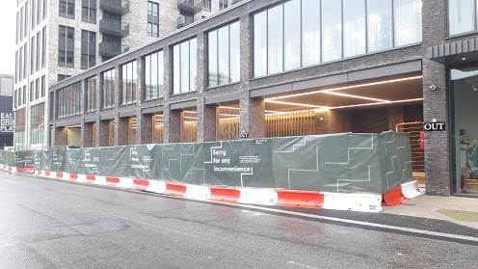
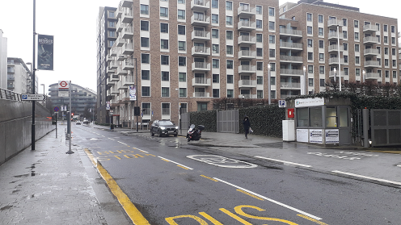
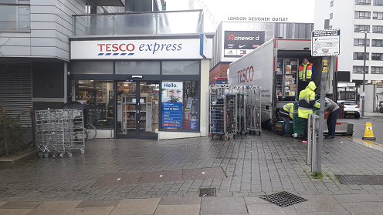
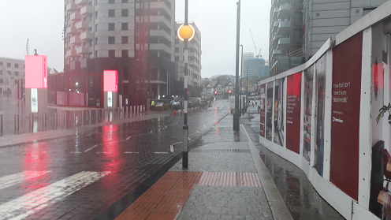
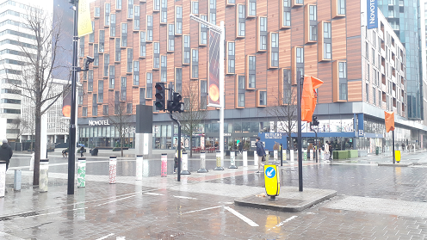
The Second Physical Site Visit
Notes:
During this site visit, where only 50 photos were taken, it was realised the survey specification would need to be amended due to some new housing being close to completion and likely to be open come the survey day in March. Questions were sent to Quintain to find out the completion date of this new housing block and it would be too close to know whether they would be operational come the survey day. It was written into the spec that this should be checked in the week preceding the survey to know whether they would need to be covered. In the end, the new housing block was operational on the day of the survey, boosting the number of vehicle accesses from 21 to 23 and the number of pedestrian accesses from 26 to 28.

Slide 15
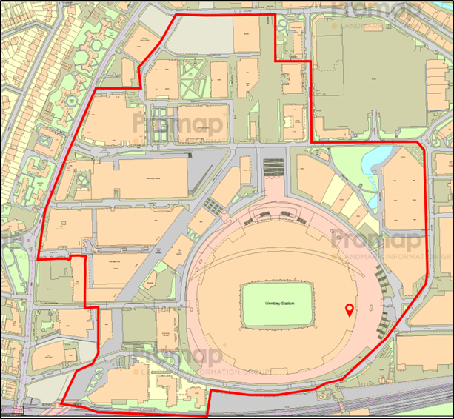
The Final Survey Specification
The final survey specification was signed off on 29th January 2023.
A few buildings within the final site boundary were not Quintain owned.
Notes:
The final survey specification was signed off on 29th January 2023 with the plan for a March 2023 survey. The final boundary of the site can be seen in the image on the slide. As mentioned, along the western boundary and in the south-west corner, this was changed from the initial site boundary map following the site visits and meeting with Quintain. Several buildings in the south-west corner and in the very north-west corner of the original area to be covered by the survey were confirmed as not being part of the site and not included in the travel plan. There are a few buildings within this final site boundary which were not Quintain owned, including Brent Civic Centre and some student accommodation blocks. However, after much deliberation with MHTC about potential ways to exclude these from the survey, it was not deemed possible, and these are therefore included. The only trips to be excluded were through trips, those people passing through the site without utilising anything within the site boundary.

Slide 16
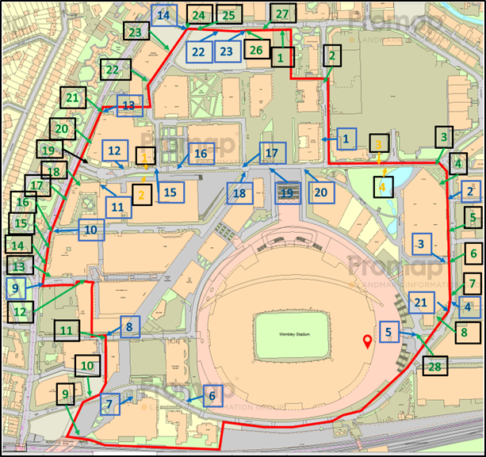
The Survey Day
The map shows everywhere the site required coverage of a vehicle, pedestrian or bus stop access during the survey.
There were 48 staff, and 40 cameras present on the day.
Notes:
The survey day finally arrived. It was Monday, 27th March 2023 and the survey took place between the hours of 06:00-24:00. Thankfully, the weather was pleasant, with no rain. The survey needed a huge 48 staff to be present on the day along with 40 cameras. MHTC had to plan where each of these 40 cameras could be fixed to and agree their locations with Quintain prior to the survey taking place and so had visited the site several times to ensure everything was ready. TRICS don’t usually attend surveys in progress, but I couldn’t resist going down to the site with both Harrys to see our plan in action. James from MHTC was also on site and we met up with him to discuss how things were going at approximately mid-morning. The TRICS team toured some of the main points of the development and I was very pleased to see the survey taking place as planned. All planning and the adaptation of the survey methodology had been worth it.

Slide 17
Observations on the Day
Despite an extensive period of planning, not everything was as expected on the survey day.
Olympic Way was, as expected, the busiest access point with approximately 27,000 trips.
Engineer’s Way (East), not as expected, was the third busiest access point with just under 6,000 trips.
Many more through trips between Engineer’s Way (East) and Olympic Way than expected.
Notes:
Despite there being almost a year between initial contact between Quintain and TRICS and the survey physically taking place, extensive planning cannot always prepare us for what will occur on the survey day. Thankfully, there were no unexploded bombs to contend with (this time) but estimating how busy each site access will be ahead of the survey is not always easy. Olympic Way, at the north of the site, near Wembley Park Station, was easily the busiest access with approximately 27,000 trips observed on the day. The eastern end of Engineer’s Way was the third busiest access with just under 6,000 trips observed on the day, and this was not expected, despite having carried out two full site visits prior to the survey taking place and MHTC also having visited the site several times to work out camera placement. Also, there were many more through trips than expected between the eastern end of Engineer’s Way and Olympic Way, with lots of students living just east of the site walking through to access the tube line at Wembley Park Station.

Slide 18
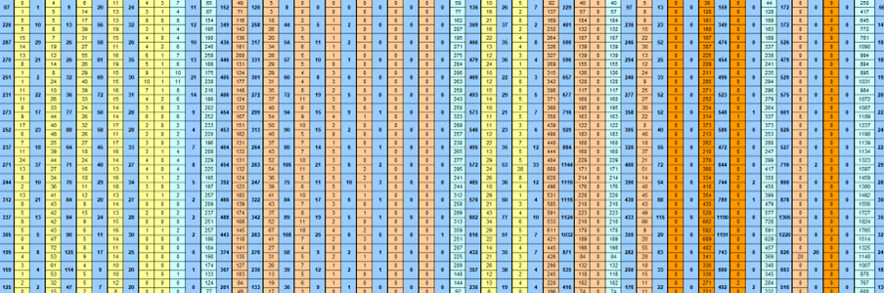
Processing the Results
The 55 access points were grouped into type and processing required a bespoke analysis table for each.
720 hours of camera footage, all 25 enumerator positions had paper forms for the 18-hour survey period.
Notes:
MHTC had the unenviable job of processing the data collected at all 55 access points from the survey day and consolidating that into a single data collection form to be submitted to TRICS for uploading to our database. The average TRICS survey has maybe two or three accesses, so this survey was the equivalent of approximately 20 TRICS surveys in that sense. However, being such a busy site, the number of trips seen on the day across the whole site would be the equivalent of significantly more than that. Usually, we expect the results of a TRICS SAM survey to be supplied by the data collection contractor within 3 weeks, but for a site of this nature much more time was needed, and it couldn’t be rushed. MHTC split each of the accesses into a different type, such as main vehicle access, residential block access, car park access, etc, and developed bespoke analysis tables for each. The standard data analysis forms used for most other TRICS surveys were not sufficient and creating these is where the experience at Westfield London again helped. Standard quality checks mainly include sense checks but there are extra checks required when factoring data, as was the case here. Due to the volumes of people, sample interviews were carried out at the busier accesses and at less busy accesses, most people were interviewed. In total, 720 hours of camera footage were analysed, and all 25 enumerator positions had manually recorded forms to be worked through, for which Marie was ultimately responsible for.

Slide 19
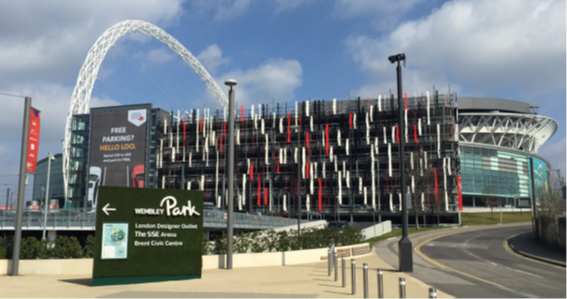
Presenting the Results in TRICS
The site needed to be added to TRICS and therefore required putting through the data validation process.
Adapted way of presenting the data in TRICS to suit the unique characteristics of the site.
Notes:
Even after the survey had been completed and the results submitted to TRICS by MHTC, it was presenting us with challenges. The survey needed to be put through the standard TRICS validation process but, as a unique site, there wasn’t a lot of other data to compare it to. When adding the survey to the TRICS database, some adaptations were needed for it to be displayed in a sensible manner.

Slide 20
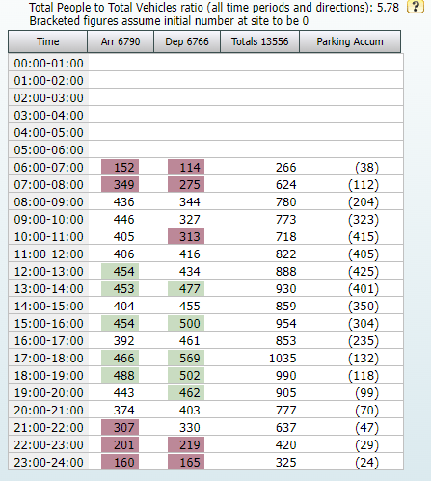
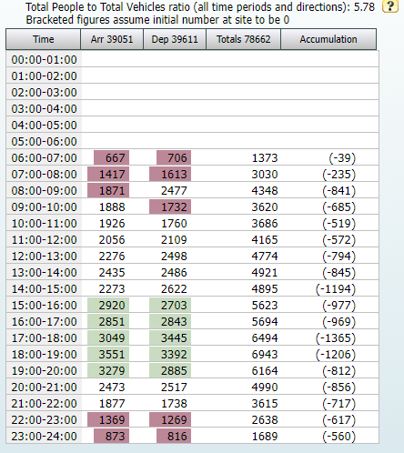
A Selection of Results
Total Vehicles
Total People
Notes:
Speaking of presenting the results, here is a sneak-peek for everyone here at some of the headline figures from the day. The table on the left shows the hourly breakdown of trips for Total Vehicles during 0600-2400. There were 6,790 total vehicle arrivals and 6,766 total vehicle departures. The figures highlighted in green are a selection of the five busiest hourly periods and those highlighted in red are a selection of the five quietest hourly periods. The table on the right shows the hourly breakdown of trips for Total People during 0600-2400. There were 39,051 total people arrivals and 39,611 total people departures. Again, the figures highlighted in green and in red are a selection of the five busiest and quietest hourly periods.

Slide 21
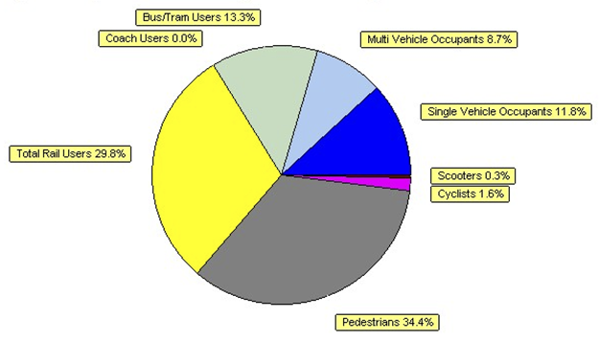
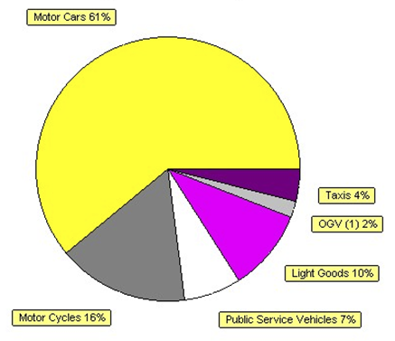
A Selection of Results
Vehicle Percentages
Modal Split Percentages
Notes:
Going a little more into detail, the pie chart in the bottom left shows a percentage breakdown of Total Vehicle movements from throughout the day, split into different vehicle modes. This shows 61% of all vehicle movements were cars, 16% motorcycles, 10% LGVs, 7% PSVs, 4% taxis and 2% OGVs. In the top right corner, the pie chart shows a percentage breakdown of the Total People movements from throughout the day, split into different modes. This shows 34.4% of all people movements were pedestrians, 29.8% were rail passengers, 20.5% were vehicle occupants, 13.3% were bus passengers and 1.9% were cyclists or scooter riders.

Slide 22
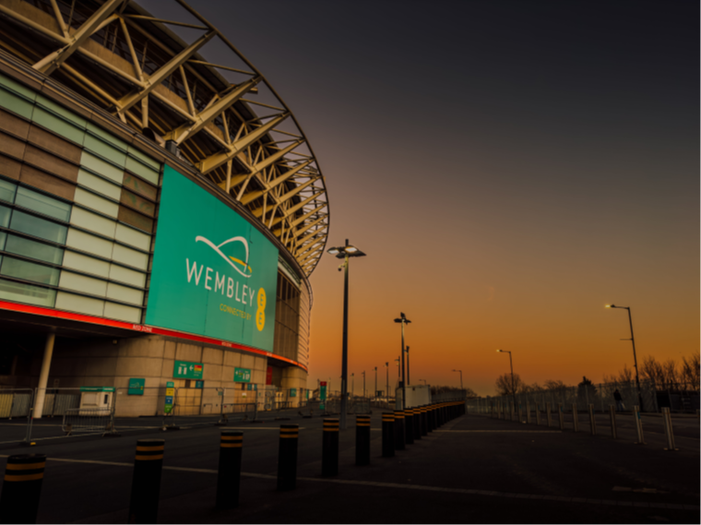
Until Next Time..?
Notes:
The Wembley Park Estate survey will be live on the TRICS database from 22nd December, when we launch TRICS version 7.10.4. The survey was considered almost impossible at the early stages but TRICS, Quintain and MHTC are all extremely happy with how the survey went and what we have all learnt throughout the process from the challenge of taking on such a large survey. As mentioned, Marie from MHTC and Ahmed from Quintain are both in attendance today so please feel free to direct any questions towards them if you have any during the Q&A session following the next presentation.

Slide 23
Image Credits
Slide 2: Gina Bichsel, downloaded from pexels.com/photo/people-walking-on-the-street-under-white-clouds-14433595 on 22/11/2023. Used in accordance with Pexels License (pexels.com/license).
Slide 4: Coombesy, downloaded from pixabay.com/photos/building-shopping-architecture-new-516377 on 22/11/2023. Used in accordance with Pixabay Content License (pixabay.com/service/license-summary).
Slide 6: JimJimJim2018, downloaded from pixabay.com/photos/wembley-football-stadium-4493328 on 22/11/2023. Used in accordance with Pixabay Content License (pixabay.com/service/license-summary).
Slide 12: Jaanus Jagomagi, downloaded from unsplash.com/photos/panning-photo-of-men-riding-horses-race-tk6q5WJopZ0 on 22/11/2023. Used in accordance with Unsplash License (unsplash.com/license).
Slide 19: Aundrup, downloaded from pixabay.com/photos/wembley-arena-london-1012637 on 22/11/2023. Used in accordance with Pixabay Content License (pixabay.com/service/license-summary).
Slide 22: Alexander Nadrilyanski, downloaded from https://www.pexels.com/photo/surroundings-of-wembley-stadium-at-dawn-15510022 on 22/11/2023. Used in accordance with Pexels License (pexels.com/license).

